Slide 1


Slide 2

#LifeKoKaroLift
SGC Coaching Session 16:
ML SESSION WITH HIRING MANAGER
Session By:

Slide 3
Agenda:
ML Algorithms
Summary
Important Interview Questions/Mock Interview
Examples
Personalized Feedback and Doubt Resolution

Slide 4
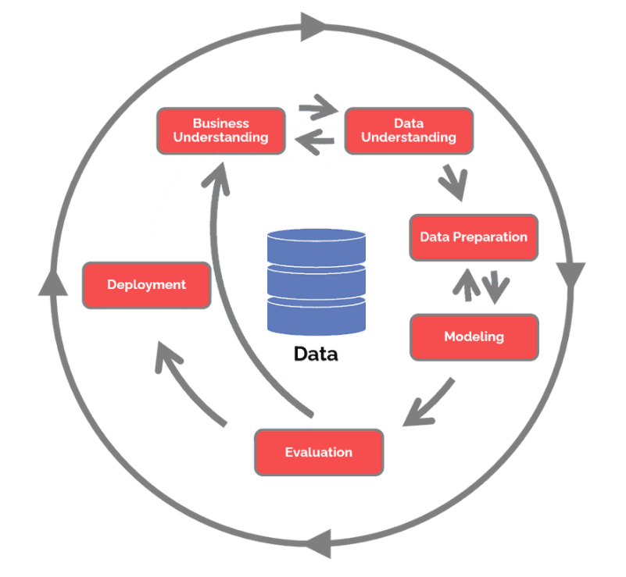
What is the CRISP – DM Framework?

Slide 5
Types of ML
TYPES OF MACHINE LEARNING
Supervised ML
UnSupervised ML
Model is trained on Labeled Data
e.g., Regression, decision trees, random forest, etc.
Model is trained on Unlabeled Data
e.g., Clustering

Slide 6
QUIZ
WHAT IS THE NULL HYPOTHESIS OF LINEAR REGRESSION?
Answer: There is no relationship between x and y i.e. coefficients are 0

Slide 7
How to approach an ML Problem?
Understand the Problem Statement and Check if Output Variable is continuous or Categorical?
Also check if it is a supervised ML problem( Data that has labels) or an unsupervised problem (Data with no labels where you need to group similar items together
In case of supervised ML, If target variable is continuous/numeric, It is a regression problem.
If it is categorical, then it is classification problem
In case of unsupervised ML, there is no target variable and similar records need to be grouped together, you can use clustering methods here
Choices for Regression:
Linear Regression
Trees
Ensemble
Choices for Classification:
Logistic Regression
Trees
Ensemble
Choices for Unsupervised Methods:
Clustering

Slide 8
Common Interview Questions – Tech
Assumptions of Linear Regression
What is Multicollinearity
What is Homoscedastic
What is p value?
What is confidence interval in simple explanation?
How does k means assign clusters?
Explain what do you mean by decision boundary?
How does logistic regression work?
Why do you need to fit and S-curve for logistic regression? Why not a straight line like linear regression?
What is the output of logistic regression model? Interpretation of probabilities?
What is F-statistic?
Explain class imbalance?
What is ROC and AUC?
Explain different metrics like sensitivity, specificity precision, recall

Slide 9
Common Interview Questions – Project with ML
Explain any ML project end to end
What are the sources of data that you considered?
What were the challenges that you faced during model building?
How do you handle categorical variables in your data
What were the number of variables in your dataset? What was your independent variable, what was dependent?
How do you deal with large number of variables in your dataset?
Did you do any outlier treatment? Why or Why not?
Share some interesting insights from your EDA
How did you do feature selection and feature engineering?
How did you deal with Multicollinearity? What effect did it have on your model and accuracy?
Why did you chose hierarchical clustering over k means?
How do you deal with class imbalance?
How did you evaluate your model?

Slide 10

Ask your Questions !
Questions?

